Slide 1
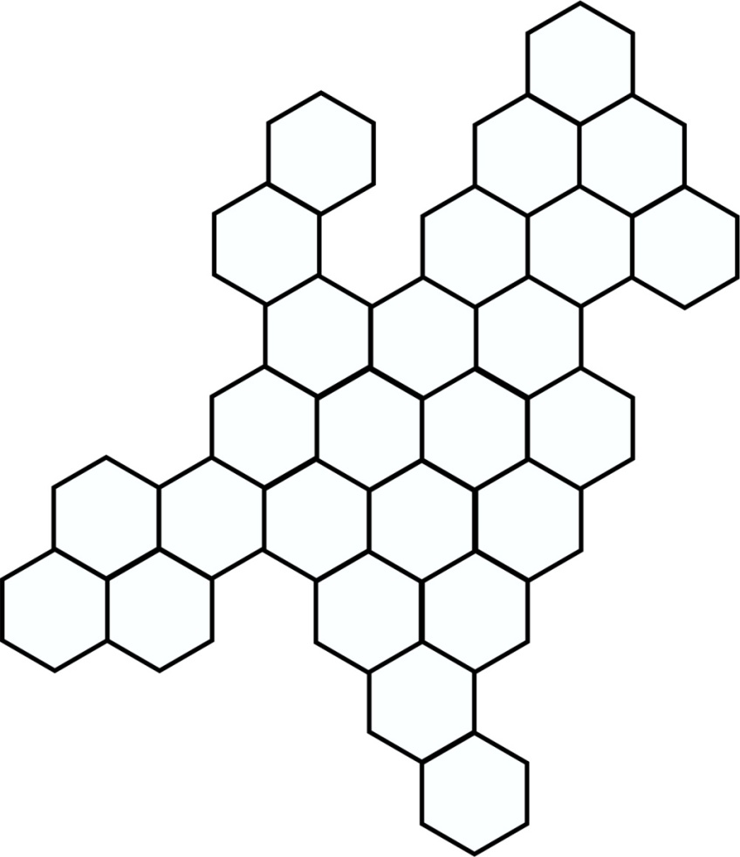
Nano in the Netherlands connecting
Prof. dr. ing. Dave H.A. Blank
MESA+ Institute for Nanotechnology
University of Twente
The Netherlands
Chair NanoNextNL
Topteam of the Dutch top sector
High Tech Materials & Systems
Dutch Advisory Committee

Slide 2

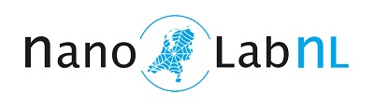
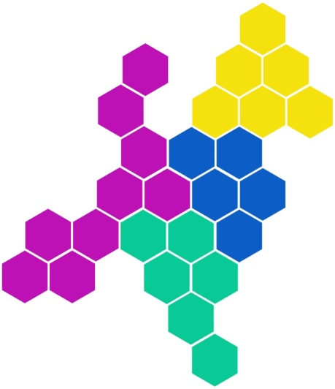


Nano in the Netherlands funding
Close co-operation between industry
and knowledge institutes
Integration of Risk Analysis and
Technology Assessment (RATA)
Co-operation between
players of all 4 regions in NL
4 locations in 4 regions
(east, south, west, north)
Combined investment strategy
Open access approach for
knowledge institutes & industry
TopSector High Tech Systems & Materials
Nanoroadmap: Cooperation industry and knowledge institutes
Strong interaction with application roadmaps
(link with ‘grand challenges’)

Slide 3
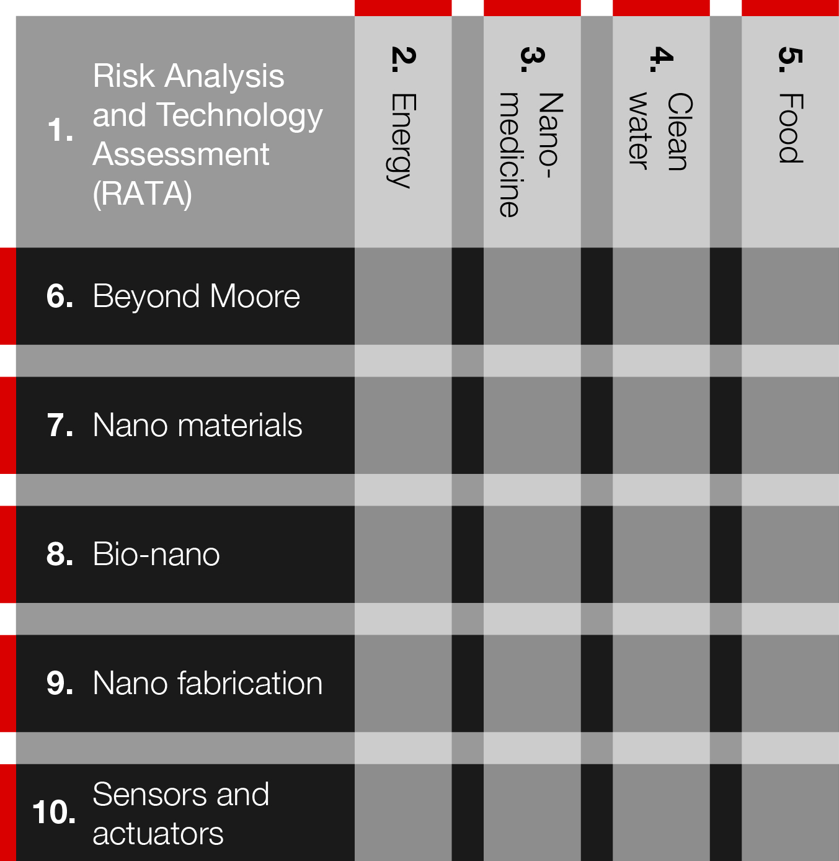
Nano in the Netherlands NanoNextNL
Societal Needs
Collaboration
beyond themes
Focus on risks and societal
challenges in generic and
application themes
Integrate RATA-aspects in
research projects
2011 - 2016
250 million euro
50% parties
50% government
28 programmes
10 themes
130 parties
30 Uni’s & institutes
20 ‘big’ industry
> 80 SME’s
Generic Themes

Slide 4
NanoNextNL performance
Key Performance Indicators
scientific position: 1200 papers
societal issues: 20% budget
joint innovations: 80 com. partners
human resources: 300 researchers
intellectual property: 115 (joint) patents
open ecosystem: 350 meetings
Notes:
Koppelen aan KPI’s

Slide 5
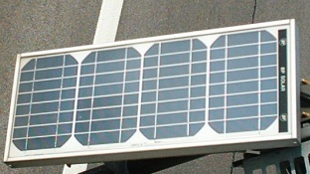

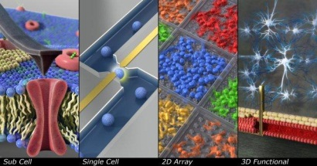
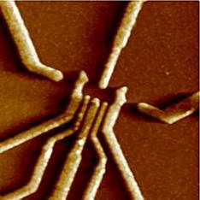
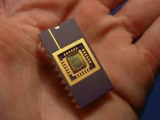
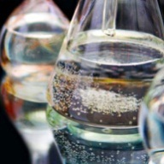
Nano in the Netherlands universities
University of Groningen
VU University Amsterdam
University of Amsterdam
Utrecht University
University Twente
University Leiden
Wageningen UR
Radboud University Nijmegen
Technical University Delft
Technical University Eindhoven
University Maastricht

Slide 6
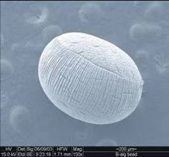
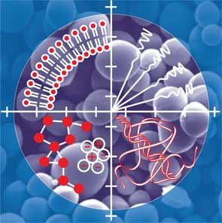
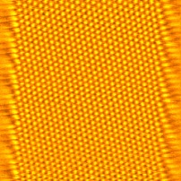
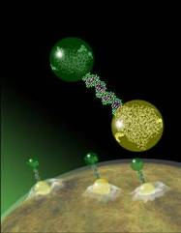
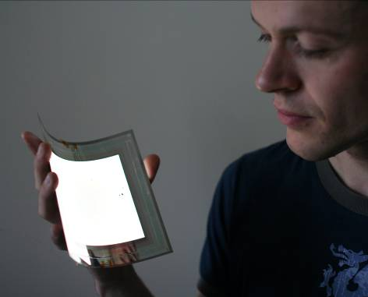
Nano in the Netherlands institutes
Netherlands Cancer Institute
ASTRON
ECN
FOM-AMOLF
Hubrecht Institute
MESA+
TNO
RIVM
TNO
FOM-DIFFER
Holst Centre
IMEC

Slide 7
Nano in the Netherlands companies
AEMICS - Amsterdam BioTherapeutics Unit - Aquamarijn Microfiltration - ASM Europe - ASML Netherlands - ATAS GL International - AVEBE UA Basic Membranes - BECO Milieumanagement en Advies - BiOrion Technologies - BLGG-Research - Boschman Technologies - Bronkhorst High-Tech - Bruker Nederland - C2V Cambridge Major Laboratories Europe - Carl Zeiss SMT AG - CellCoTec - Centre for Concepts in Mechatronics Check-Points - Chemtrix - Cosine Research - Culgi DANNALAB - Danone Research - DC4U - Delmes – Deltares - Demcon Twente – DevLab - Dutch Space Encapson - Enceladus Pharmaceuticals - Environmental Monitoring Systems (EMS) - Enza Zaden - FEI Company - Femto Engineering - Flowid - FrieslandCampina - FutureChemistry Holding - HyET - Innosieve Diagnostics - ISIS - Innovative Solutions In Space - IVAM Environmental Research UVA - KWR Water - Leiden Probe Microscopy - LinXis - LioniX - MA3 Solutions -MAPPER Lithography Medspray - XMEMS - MicroDish - MicroNextt - Micronit Microfluidics - Minus9 - Nano-FM - Nanomi - Nanosens - Nikon Instruments Europe - NT-MDT Europe - NXP Semiconductors - Océ Technologies NV - OM&T Ostendum R&D - OTB Solar - PamGene International - PANalytical - Philips Electronics Nederland - PhoeniX - Phycom - PhytoGeniX Polyvation - Podiceps Purac Biochem - QTIS/e - Shell Global Solutions International – SmartTip - SolMateS - Stork Veco - Surfix - SyMo-Chem - Syncom – Syngenta - Synvolux therapeutics - SystematIC Design - Thermo Fisher Scientific - Twente Solid State Technology - Tytonis - Unilever R & D - U-protein Express - VibSpec-Training - VION Food Nederland - Vitens Laboratorium - X-Flow - XiO Photonics

Slide 8
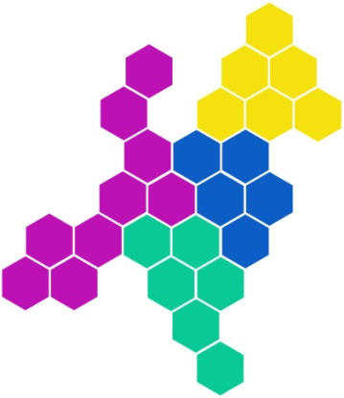
Nano in the Netherlands numbers
Investments in nano in 2015
Investments of industry in nano M€ 70 (35 % cash)
Grants Dutch science foundations M€ 50
EU grants and projects on nano M€ 20
Deliverables in nano in 2015:
Labour: over 1000 jobs in nano-related high tech extra
Number of start-up companies on nano: 15
Number of patents: 3rd country in Europe on nano and the 6th country worldwide
Number of theses on nanotechnology: 260
Number of papers in Web of Science: 1400

Slide 9
Nano in the Netherlands regions
  NORTH
  Energy Valley
  Sensors
WEST
Amolf NanoPhotonics
BioNano
NanoPhysics
  EAST
  NanoTechnology
  High Tech factory
  Food Valley
  SOUTH
  Brainport
  ASML, NXP, Philips
NanoElectronics

Slide 10









Nano in the Netherlands region south
Brainport Eindhoven leading European top technology region
worldclass companies with unique market positions (Philips, DAF, NXP, FEI, ASML) and highly innovative SMEs, specialized in HTS&M
Strong supply chains where research, development, design and production occur in close proximity
Open innovation where parties share knowledge in an open environment before they enter the marketplace
Triple helix cooperation between government, business and knowledge institutes

Slide 11









Nano in the Netherlands region east
Kennispark Twente Innovate & Accelerate
Entrepreneurial region where starting (spin-off) companies in Twente benefits from various support
Open Innovation Centers where joint initiatives, knowledge and innovations related to HTSM are shared
High Tech Factory where SME’s in nanotech can share production facilities, including High Tech Fund
Over 50 spin-off companies on nanotechnology are emerged from MESA+ Institute for Nanotechnology

Slide 12
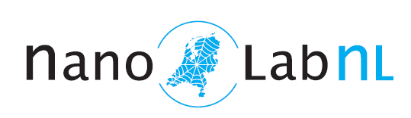
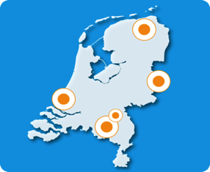


NanoLabNL
Providing an open-access infrastructure
for research and innovation in nanotechnology
NanoMaterials, NanoFabrication, NanoFluidics, NanoElectronics, BioNano, NanoMedicine, ….
National consortium at 4 locations:
  Eindhoven
  Groningen
  Twente
  Delft

Slide 13
Investment programs
  2003 – 2009: NanoImpuls
  2005 – 2010: NanoNed, 85 M€
  2009 – 2014: BioNanoLab, 37 M€ for bionano, nanomedicine, risk analysis
  2014 – 2018: QuEEN, 17 M€ for Quantum Electrical Engineering with Nanotechnology
‘NL Roadmap for Large-scale Research Infrastructures’
  2008: NanoLabNL on the first roadmap
  2012: NanoLabNL on the updated roadmap
  215 M€ for 2013 – 2022
And…
  new buildings Delft, Eindhoven, Twente
  re-investment fund, 7 M€
  Improving transnational access

Slide 14
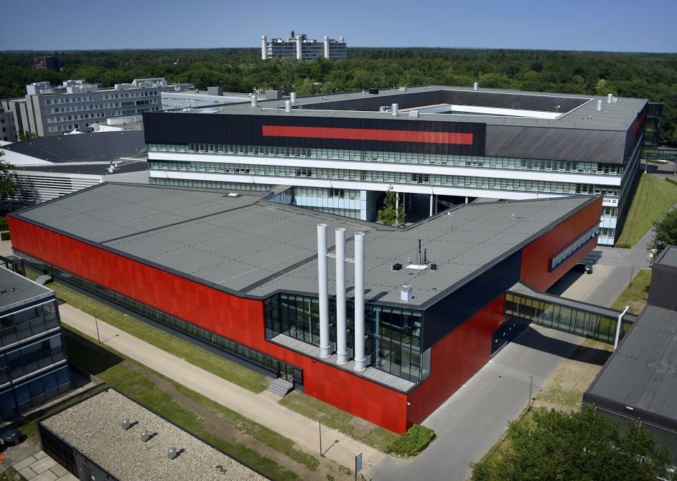
MESA+ NanoLabNL
Combines nanotechnology, microsystems & materials science at UTwente
Yearly turnover: 55 M€ with 60%
from external sources
> 450 refereed papers
>14,000 citations
Staff: 570 scientists:
44 full professors
62 Tenure Tracks, associates
250 PhD, 90 PostDoc’s
Technicians, guests, visiting

Slide 15



MESA+ Commercialisation
From idea to venture
Concept
Protection
Development
Product development
Market
Research
Spin-off
Protection
- patent application
Development
- workshops
- subsidies
- pre-seed grants
- spin-off
Spin-off
- facility sharing
- production facilities
- equipment fund
Support from MESA+

Slide 16
















>50 MESA+ Spin-off’s

Slide 17
HTSM nano-roadmap future
Overview challenges | Health | Health | Food | Energy | Energy, Transport | Secure & Inclusive Society | Circular Economy
Specific field/ Enabling tech | personalized & targeted medicine | PoC diag-nostics | food safety; personalized food | nano for solar | conversion and storage | nano devices for ICT, Cyber, Big Data | new materials / processes (nano&bio insp.)
Nano-fluidics
Molecular biology
Design of bio- systems
RATA
Nano-photonics & devices
Nano-analytics; equipment
Nano-Materials & processing
Surfaces & thin films (coatings)
Catalysis
f

Slide 18
HTSM nano-roadmap future
Overview challenges | Health | Health | Food | Energy | Energy, Transport | Secure & Inclusive Society | Circular Economy
Specific field/ Enabling tech | personalized & targeted medicine | PoC diag-nostics | food safety; personalized food | nano for solar | conversion and storage | nano devices for ICT, Cyber, Big Data | new materials / processes (nano&bio insp.)
Nano-fluidics
Molecular biology
Design of bio- systems
RATA
Nano-photonics & devices
Nano-analytics; equipment
Nano-Materials & processing
Surfaces & thin films (coatings)
Catalysis
f
Organs- on-Chips / human disease model
Synthetic Biological Systems & Devices
Nano-materials for Energy
New materials for “Green ICT”
3D Nano-structuring & Metrology

Slide 19
Nano in the Netherlands connecting you
Open for connecting and cooperation
within and between regions worldwide

