Slide 1
Israel as a Global Lab and Beta Site
(on Nano Scale)
Prof. Eugene Kandel
Start-Up Nation Central
22.2.2016

Slide 2
From need to innovation: Israeli case
Three conditions for success
Long term local need
Recognized excellence and track record
Growing global demand
Success stories: Defense, ICT, Cyber security
Notes:
כיוונים במחקר והפיתוח הטכנולוגי

Slide 3
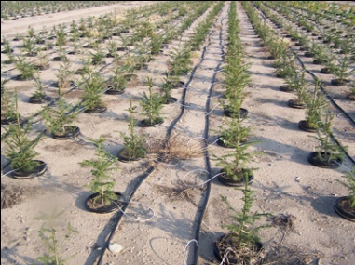
Israel as a Global Lab and Beta Site
Need
Innovative Solutions
Global Scale Up
Local Testing

Slide 4
Keys to success
Private sector leadership
Focus on global challenges
Long term commitment by government
Quality and breadth of relevant research

Slide 5
New Success Stories
Sustainability:
WaTech,
AgroTech,
Healthcare: molecules, devices, systems, data
Energy
Big Data (Algo, Computer vision, Machine learning and various applications)
Nano.
Notes:
כיוונים במחקר והפיתוח הטכנולוגי

