Slide 1
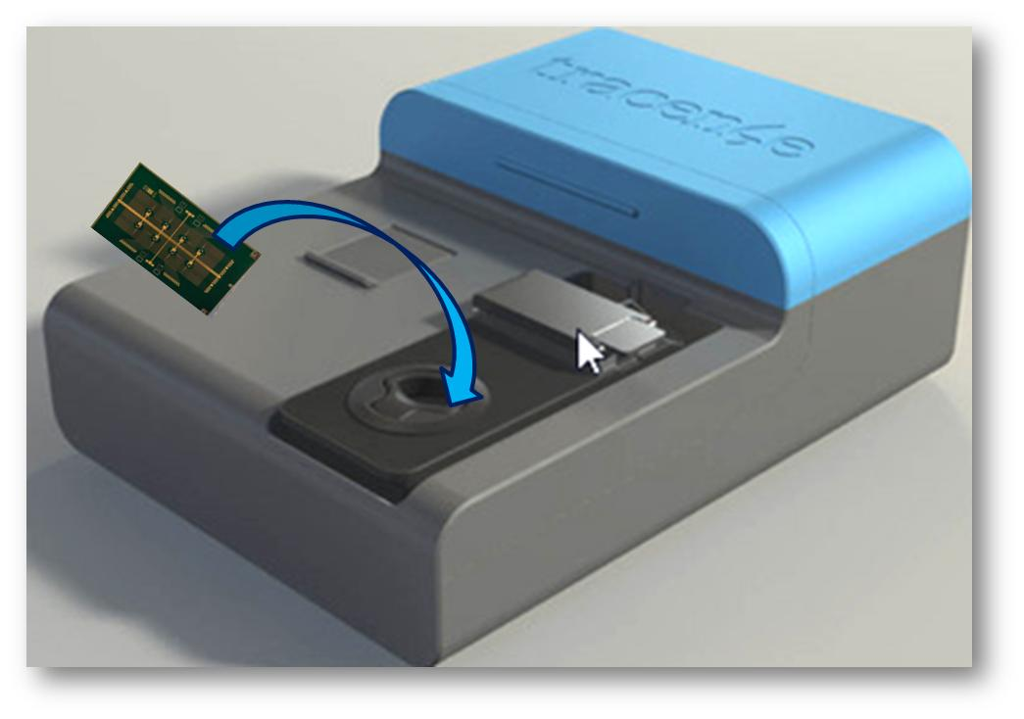
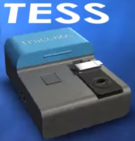
Company Presentation
Mr. Noam Noy V.P. R&D
February 2016
Tracense Systems Proprietary

Slide 2
Intro
Need
Market
Solution
Financial
Team
Tracense Electronic Nose
Tracense provides the world’s leading chemical detection solutions based on proprietary nano-technology for homeland security & law enforcement broad needs.
Tracense Systems Ltd.

Slide 3
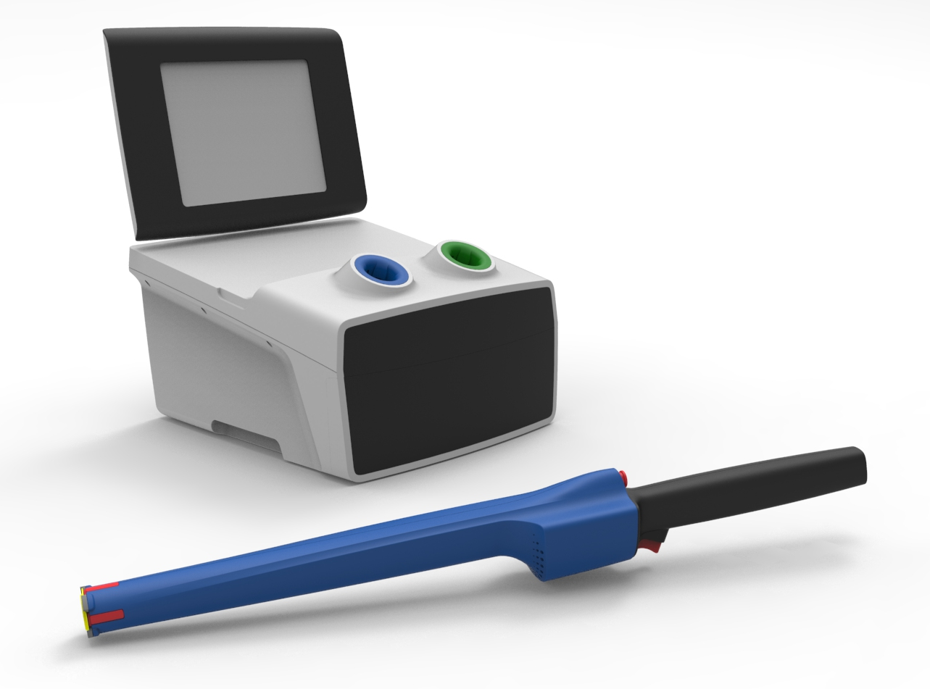
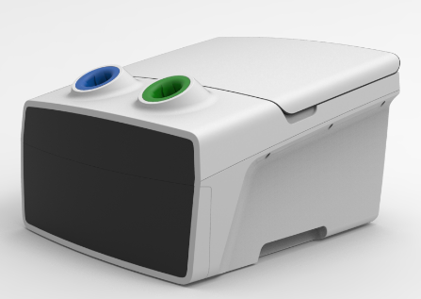
Intro
Need
Market
Solution
Financial
Team
TESS Explosives Detector
Tracense Systems Ltd.

Slide 4
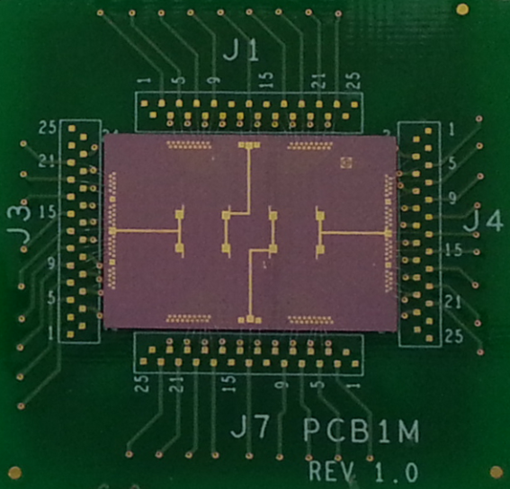
Intro
Need
Market
Solution
Financial
Team
TESS Detector Chip
Multiple simultaneous reactions between target and sensors on a silicon chip.
A laboratory on a chip!
Tracense Systems Ltd.

Slide 5
Intro
Need
Market
Solution
Financial
Team
Tracense Threat Detectors
Key Characteristics
Ultra high sensitivity – PPT to PPQ concentration levels
Exceptional specificity
Allows adding new target materials by SW upgrade.
Applications: explosives, Chem/Bio Warfare Agents, narcotics and more
High throughput
High reliability, low false positive rate
Samples collection versatility: vapor, liquid and particles
Safe: no radioactive source, no high-V source
Portable, battery operated
Easy interconnection & integration with C4ISR systems
Low cost - system and operation
Tracense Systems Ltd.

Slide 6
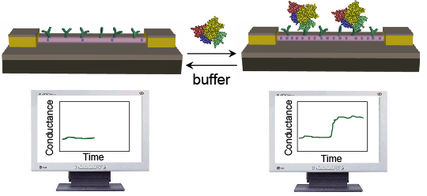
Intro
Need
Market
Solution
Financial
Team
Basic Technology
How does a Tracense “nano-sensor” work?
Generic sensing platform able to detect a wide range of chemical and biological molecules.
Tracense Systems Ltd.

Slide 7
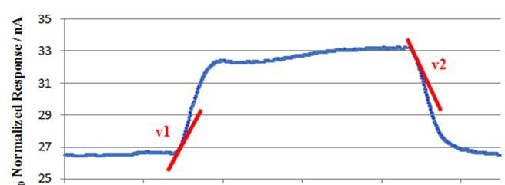
ID Principles
Equilibrium Steady State
desorption
Absorption
Base Line
Onset Kinetic Ratio Independent of Concentration
Complimentary identification methods: thermodynamics & kinetics
Tracense Systems – All Rights Reserved

Slide 8
Pattern Generation
Multiple receptors
Sample
Clean
Hundreds of nano-sensors in one array
A unique fingerprint
Results
Tracense Systems Proprietary

Slide 9
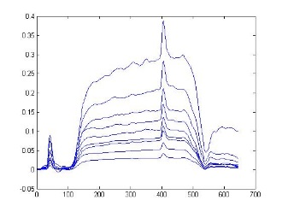
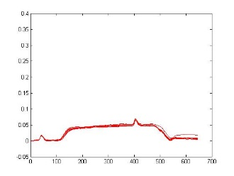
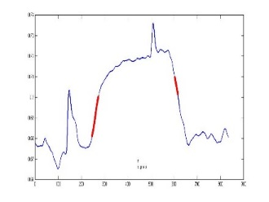
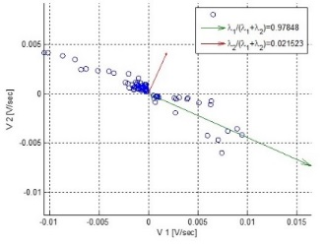
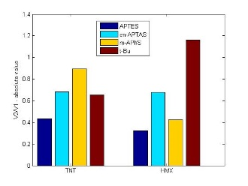
Intro
Need
Market
Solution
Financial
Team
5-Tier ID Algorithm
Normalization
Initial Kinetics
X 8
Identify
Reject Irregular Signals
Raw Data
All channels
Library
of threats
Statistical Analysis
Sample
Create Pattern
Tracense Systems Proprietary

Slide 10
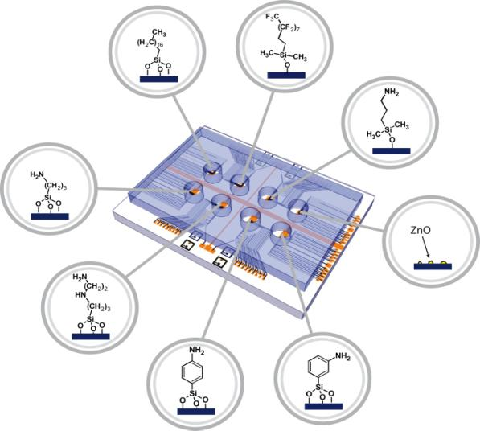
Intro
Need
Market
Solution
Financial
Team
Multiple Reactions
Match & optimize reaction set to application
Tracense Systems Ltd.

Slide 11
Intro
Need
Market
Solution
Financial
Team
Distinctive Graphic Patterns for Diverse Explosives
Tracense Systems Ltd.

Slide 12
Patents & Applications
Intro
Need
Market
Solution
Financial
Team
“Aligned Nanoarray and Method for Fabricating the Same “, granted, US Patent 8,632,873
“Functionalized Nanostructures for Detecting Nitro-Containing Compounds“, granted, US Patent 9,063,053
“Nanostructures and Process of Fabricating the Same”, published PCT application PCT WO2013/098657
“Systems and Methods for Identifying Explosives”, filed PCT/IL2014/050070
Building a strong IP portfolio to protect and commercialize the key company technologies
Proven, disruptive, uniquely differentiated, protected and high-barrier technology
Tracense Systems Ltd.

Slide 13
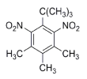
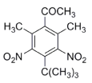
Experimental Results
Intro
Need
Market
Solution
Financial
Team
Tested Explosives
TNT
RDX
HMX
PETN
DNT
NG
Tetryl
TATP
HMTD
AN
Tested Interferents
2,4 DNP
p-nitrophenol
Aniline
.
k
Commercial
Military
Improvised
Home made
Musk matl’s in cosmetics and fragrances
Measure vapor, particles & liquids with orders-of-magnitude higher sensitivity
Tracense Systems Ltd.

Slide 14
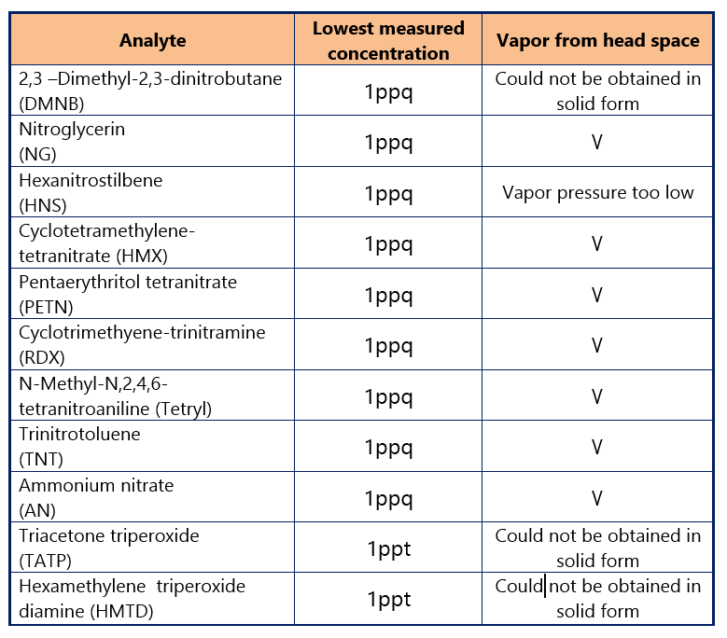
Sensitivity and Vapor Tests
Intro
Need
Market
Solution
Financial
Team
23 explosives were tested for sensitivity and vapor detection capabilities
Standard solutions down to 1 ppq (part per quadrillion level), and
Vapor collected from the head space at vapor pressure equilibrium in an enclosed volume
Tracense Systems Proprietary

Slide 15
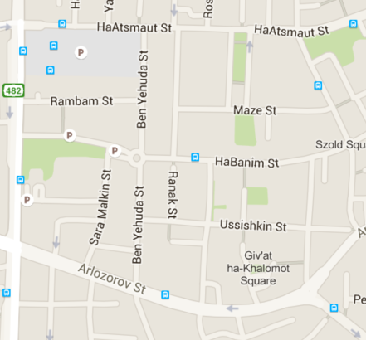
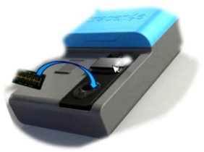
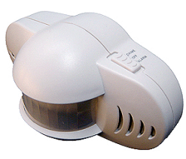
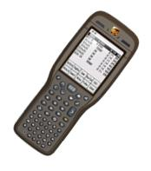
Intro
Need
Market
Solution
Financial
Team
Immediate
Short Term
Mid Term
TESS
Stand-alone
Stationary
Sampling
Explosives
p-TESS
Stand-alone
Hand-held
Air Sampling
Explosives
i-TESS
Integrated
Stationary
Air Sampling
Explosives/…
m-TESS
Stand-alone/Integ
Stationary
Air Monitor
Explosives/…
Road Map
a-TESS
Add-on
Hand-held
Air Sample/Monitor
Explosives/…
Tracense Systems Ltd.

Slide 16
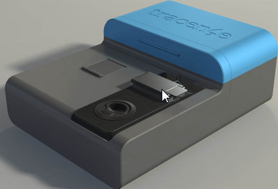
Intro
Need
Market
Solution
Financial
Team
Thanks
Thank You!
Noam Noy V.P. R&D
Noam.noy@tracense.com
+972-522454886
www.tracense.com
Tracense Systems Proprietary

