Slide 1
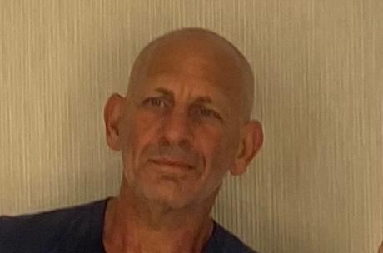
Dr. Azmon, an ophthalmologist, is one of the co-founders of Notal Vision and was previously the company’s CEO. After Notal Barak co-founded Azura Ophthalmics, Pres-By Vision Journey1, Azura ophthalmics, Potentiaa and V6,. Dr. Azmon formerly worked at the Ophthalmology Department of the Tel Aviv Sourasky Medical Center.. Dr. Azmon has been a venture partner in Accuitive Medical Venture and a consultant for many venture funds and through that has been involved in the development of a number of medical technologies. He was awarded the Israeli Science Foundation grant for his research in visual cortex and object recognition. Dr. Azmon received the inventor of the year reward from the OIS organization
Dr. Azmon holds an M.D. degree from Ben-Gurion University of the Negev, Israel.

