Slide 1
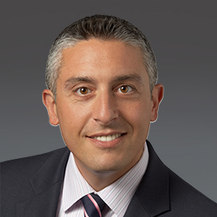
Beni Surpin – Goodwin – Short Bio
Beni Surpin Partner, Licensing & Collaborations
Silicon Valley | Los Angeles
+1 650 752 3331 | +1 213 426 2660
Mobile: +1 858 337 5727
bsurpin@goodwinlaw.com
Beni Surpin is a senior partner in the firm’s Life Sciences group, where he focuses on global technology and commercial transactions. Beni counsels international and domestic companies on a variety of legal and business issues in complex technology, intellectual property and commercial deals across a wide range of industries, including in the life sciences, medical devices and healthcare sectors. His practice centers on complex collaborations between companies involving technology transfer and licenses, at all stages from inception to full commercialization, to generate and enhance product lines and services through access to new technologies.
Among the many recognitions received by Beni over the years, Chambers USA: America’s Leading Lawyers for Business noted that Beni wins plaudits for his brilliance as a practitioner, and is a growing presence in the legal community. Chambers also noted that “sources compliment his ‘amazing command of the law,’ which ‘is blended with practical consideration of what drives business,’” and The Legal 500 ranked Beni in various categories, including technology transactions, healthcare and life sciences, and patent licensing (Tier 1).

