Slide 1
Extracting The Untapped Ag-biologicals Value
Dor Kestecher, VP of Business Development
April 2023

Slide 2
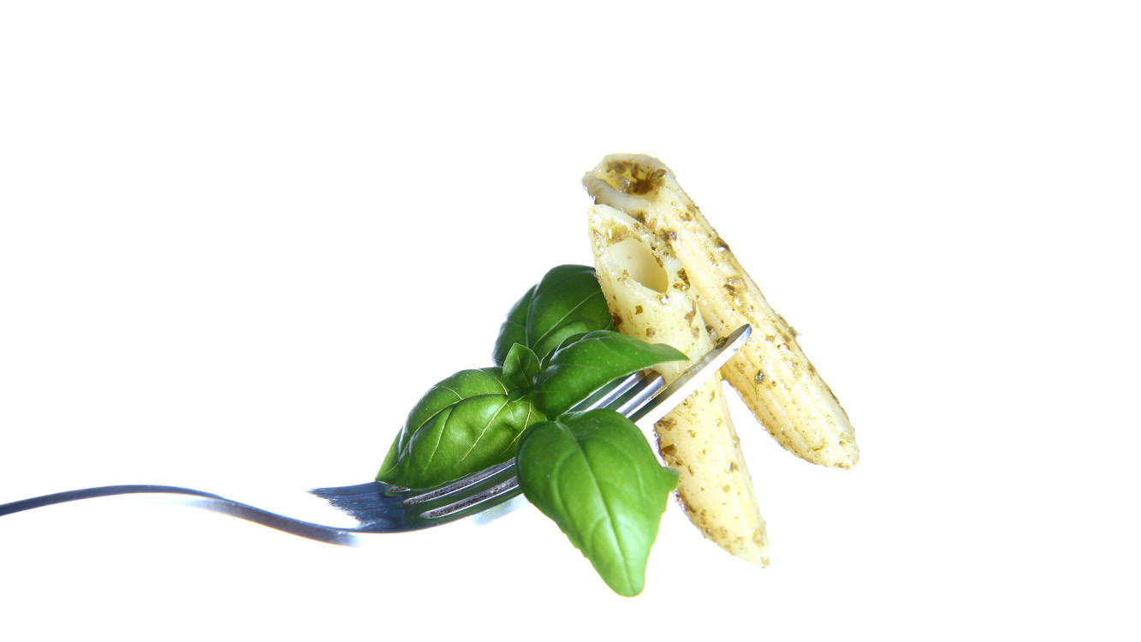




Healthier
food
The fork
influences
the farm
Sustainable environment
Productive agriculture
Better
value

Slide 3
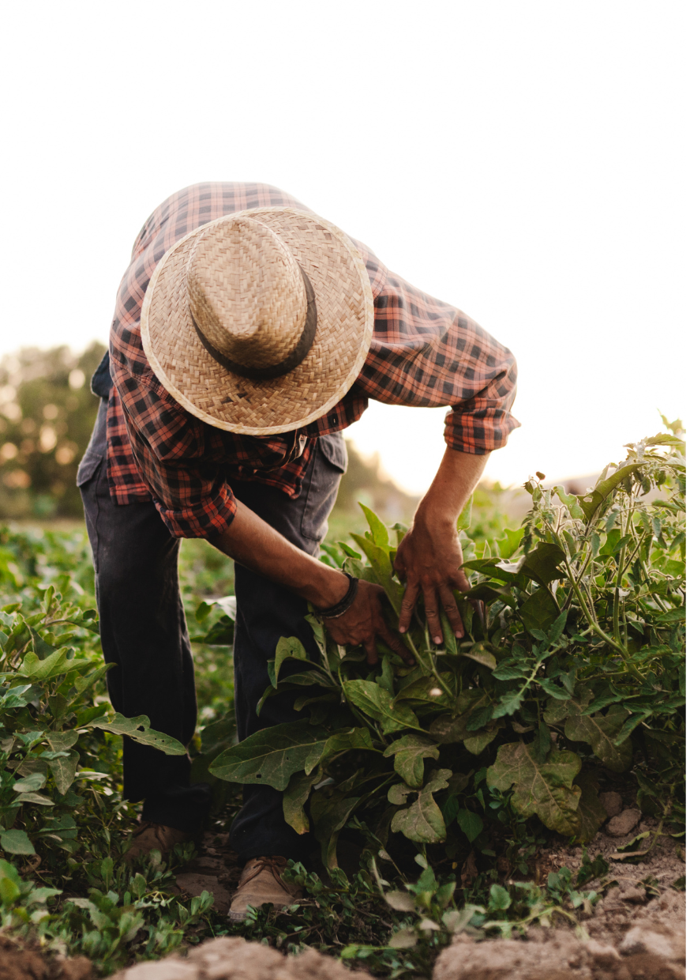


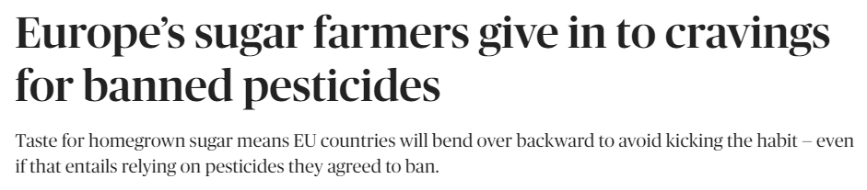
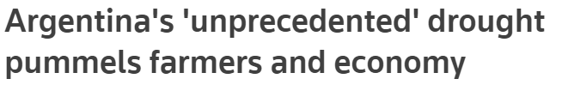
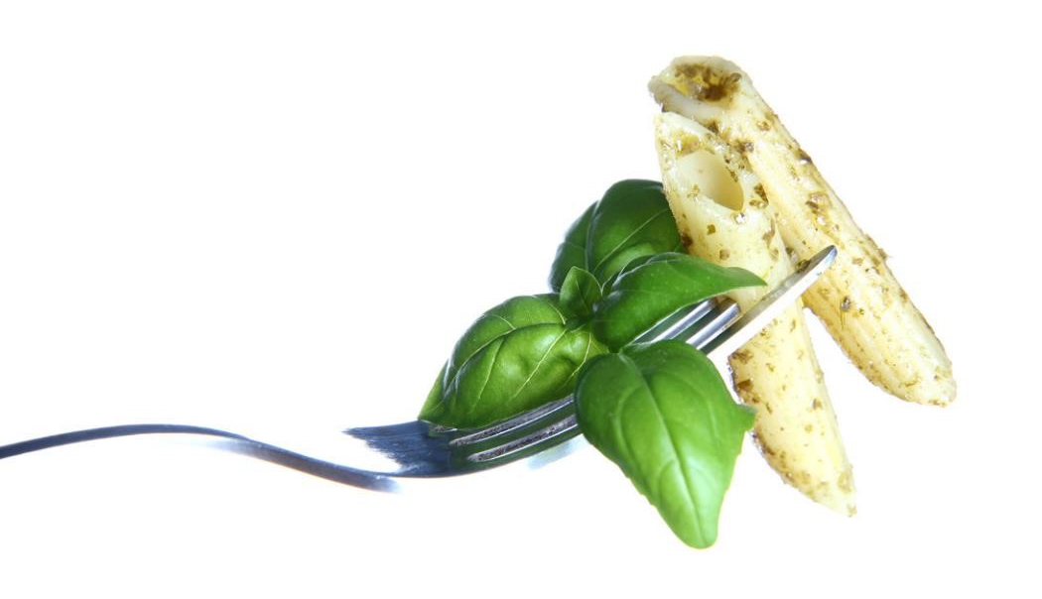
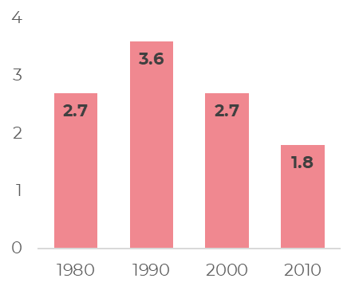
Farmers are facing increasing pressures to remain sustainable
Regulatory Restrictions
Climate Challenges
December 2020
March 2023
Following ban of neonicotinoides in 2019, Sugar beet yield in France dropped by 20% the following year
Consumer Demands
Limited Toolbox
The fork
influences
the farm
Launches of new active ingredients have been dropping over the past 3 decades

Slide 4
The Ag-Biologicals opportunity
Driving healthier crops, sustainability and productive agriculture
Consumer Health
Less residues
Less applicator exposure
26
12.9% CAGR
16
Regenerative Agriculture
Improving soil fertility
Integrated pest management
10
E
Sustainability
Renewable resources
Increased uptake of fertilizers
* Company estimations, based on data shared by Dunham Trimmer during ABIM 2022

Slide 5
The Ag-Biologicals
untapped potential
Crop Protection
& Fertilizers
Ag-Biologicals
Today
Sustainability | + | +++
Efficacy | +++ | ++
Consistency | +++ | +
Commercial viability | +++ | +

Slide 6


Our Mission
Improve food quality, sustainability
and agriculture productivity through microbiome based ag-biologicals technology and products

Slide 7


Lavie Bio
Next generation Ag-Biologicals
Crop Protection
& Fertilizers
Ag-Biologicals
Today
Ag-Biologicals
Next generation
Sustainability | + | +++ | +++
Efficacy | +++ | ++ | +++
Consistency | +++ | + | +++
Commercial viability | +++ | + | +++

Slide 8










Biology Driven Design platform
¹
²
Discovery
Optimization
Commercialization
Billions > Promising few
Promising few > Product
Product > Label Expansion
¹ Lavie Bio holds an exclusive license to use Evogene’s MicroBoost AI tech engine for the discovery and development of products in Lavie Bio’s field of activity.
² As part of Corteva’s investment in Lavie Bio in 2019, Lavie acquired the assets of Taxon Biosciences, including a large microbial collection.

Slide 9
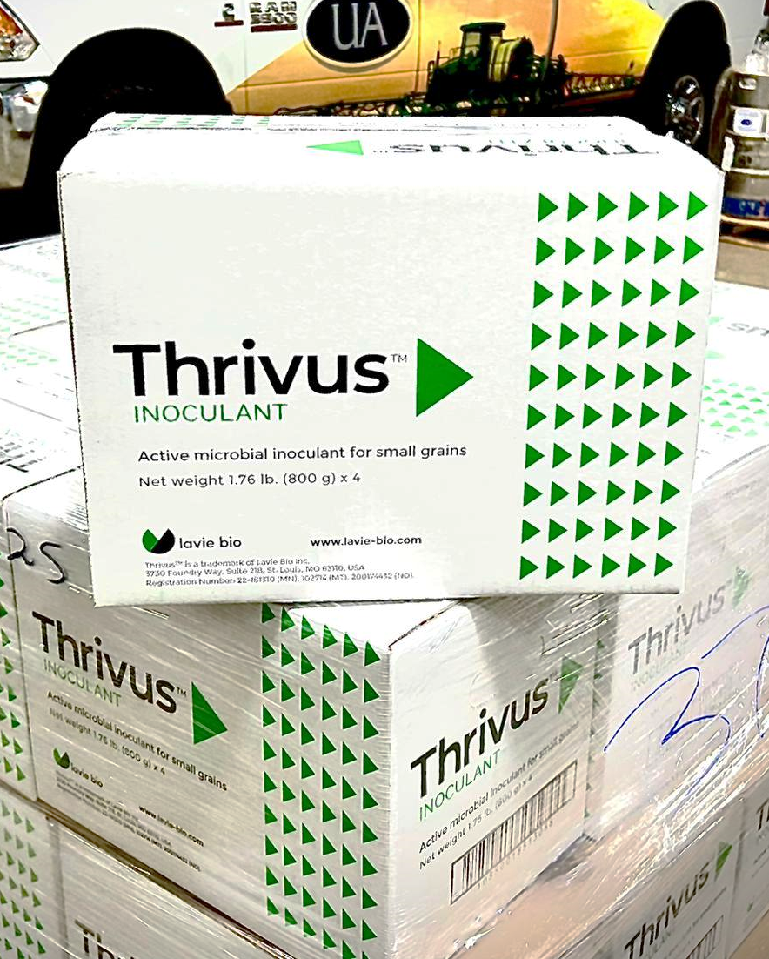

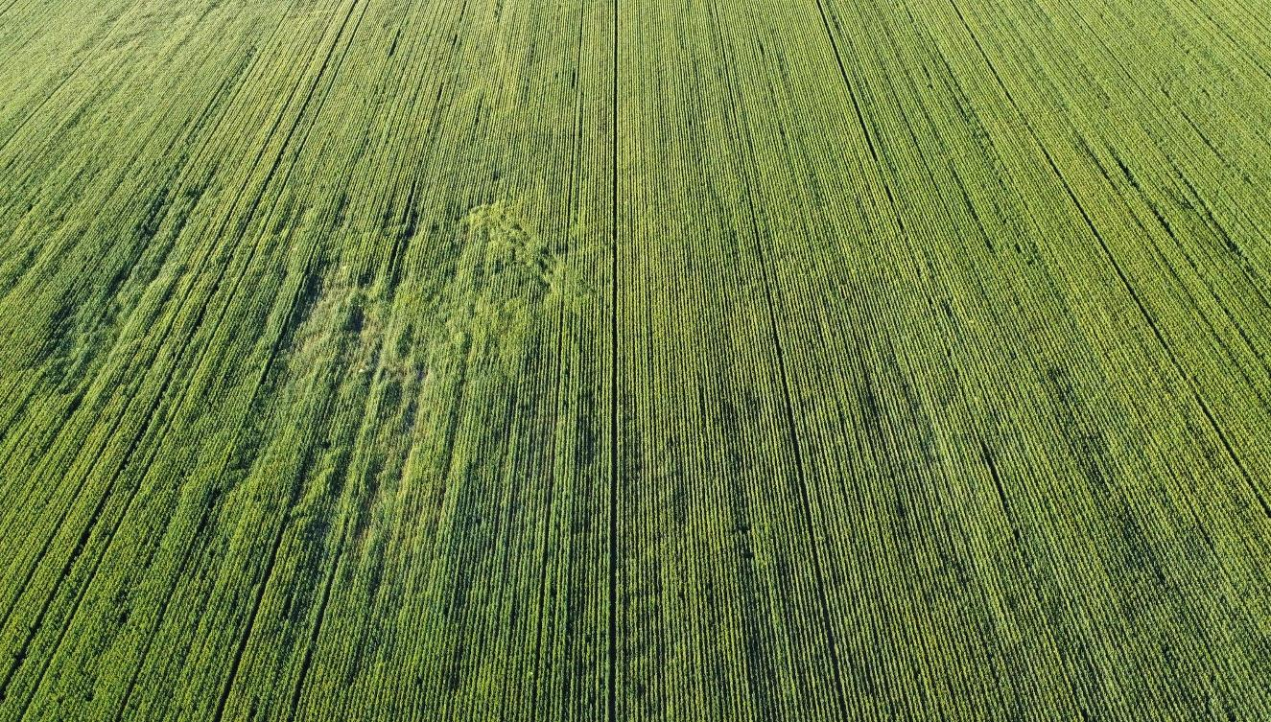


Commercialization 2022
Five years from Discovery
Yield improvement (%)
106%
Check
104%
103%
102%
101%
Other
Ag-Biologicals
Control
Launched in 2022 in North Dakota
Expansion in progress in the US and in Canada
Sub-optimal field areas are significantly improved with Thrivus
Comparative difference can easily be observed with the naked eye
Improved root development and increased biomass are consistant with Thrivus™

Slide 10
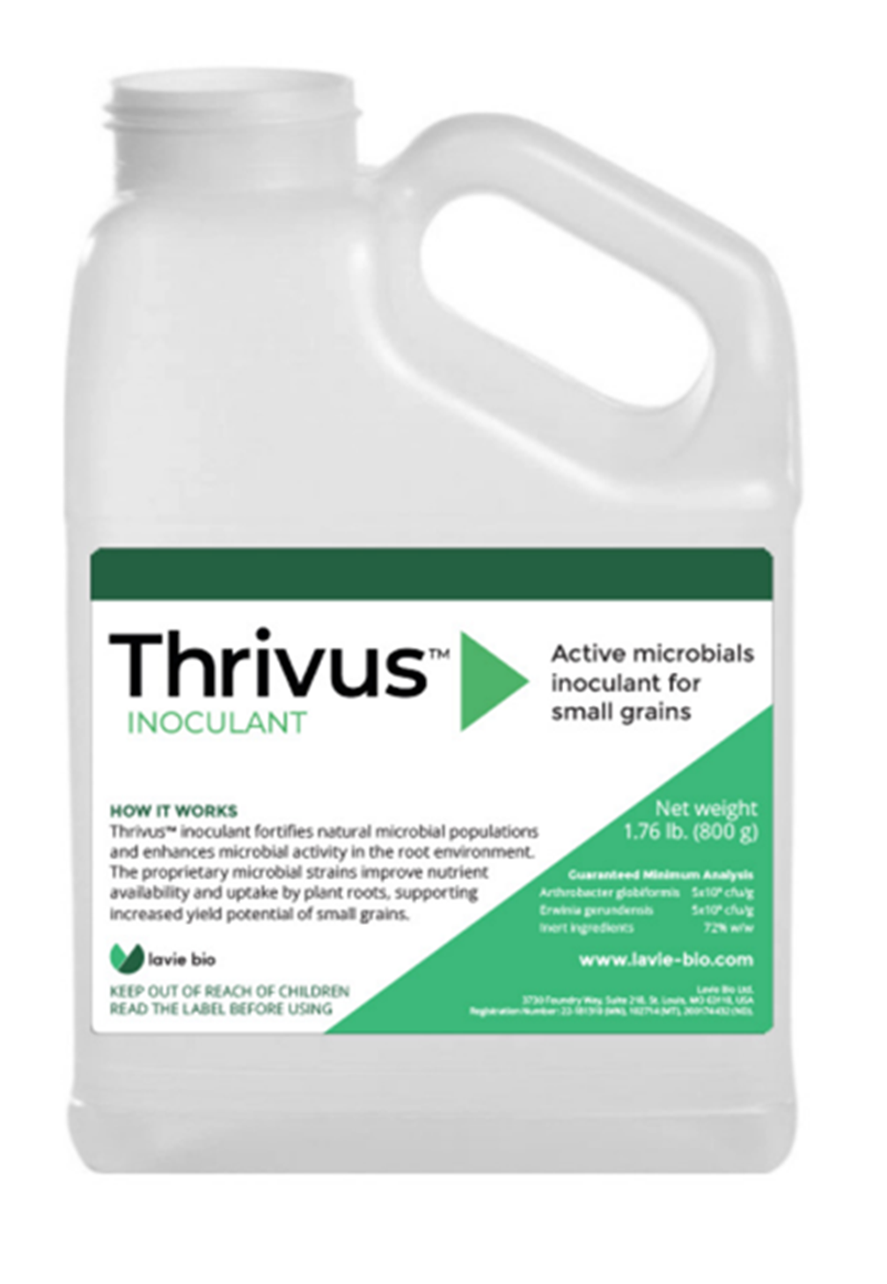
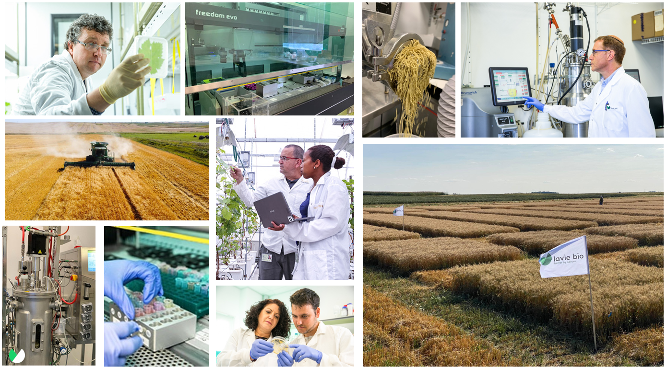






From Idea to Commercial Launch in 5-6 years
Launch to Commercial Scale-up
Direct Model
Sales through channels
Retain maximal value internally
B2B Model
Royalty dependent
Lavie Bio has unique end-to-end capabilities to bring products quickly to market
Supporting the development of scale-up secures increased value retention

Slide 11
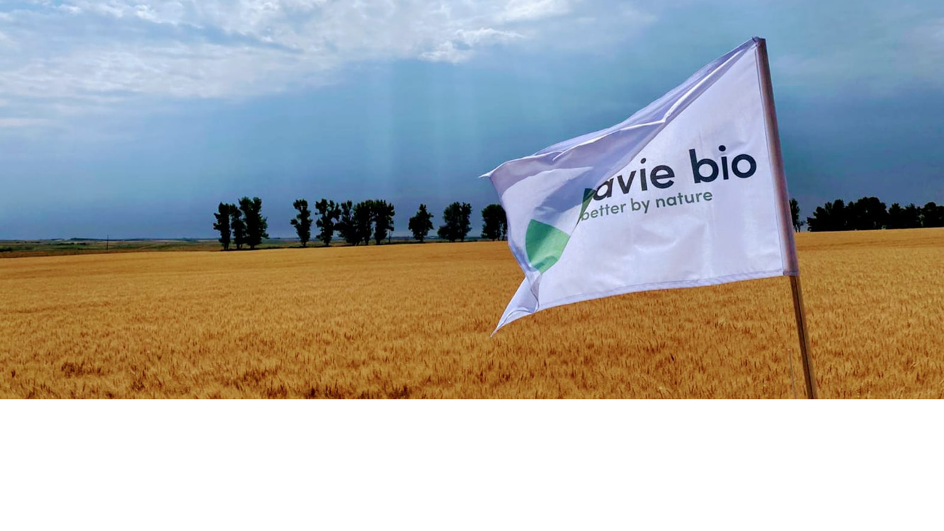
Thank you!

