Slide 1
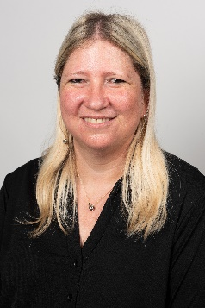
Ilanit Adesman
Partner
Background
Ilanit joined the firm in 1998 and was appointed a partner in 2007.
Ilanit is the head of LOB of the Insurance and Fintech. Ilanit has extensive experience in the field of banking, insurance, provident and pension in terms of audit, operational and financial risk management, as well as in AML, FATCA, CRS advisory projects.
Under Ilanit's management, projects are carried out in many areas, such as: consulting in the implementation of IFRS 17, consulting in converting core systems, advising banks and institutional bodies in implementing AML, FATCA and CRS, data improvement projects, and auditing in a number of companies in the banking, insurance, provident and pension companies.
Ilanit is also very involved in the Fintech & Insurtech industry in Israel, making connections between the fintechs & Insurtechs and the Banks and Insurance companies and also advising Fintechs & Insurtehcs and new digital banks or new digital insurance companies on different subjects.
Professional and industry experience
IFRS 17 and Solvency II advisory services and audits, including actuarial DD.
Advising fintechs, insurtechs, digital insurance companies and digital banks.
ISAE 3402 and ISAE 3000 for financial operational subjects, including provident funds operations, trust funds operations and custodian services.
AML, FATCA and CRS advisory services both to the financial industry (Banks, Insurance companies and large Investment houses).
Ilanit provides consultation services to banks and insurance companies in the process of choosing, purchasing and implementing new IT systems, including core systems, SAP systems (including SAP FPSL and SAP HANA) and integration of Fintech and Insurtech systems.
Ilanit is responsible for the ongoing audit supervision of actuarial calculations and risk management for companies in the fields of insurance companies, pension funds, provident funds and IAS 19.
SOX 404 advisory projects in financial institutions as well as industrial and software companies. Part of the projects took place in subsidiaries abroad (mainly in the US and in Europe).
Various IT leading projects in Israel’s largest financial institutions (banks, insurance companies, etc).
KPMG Somekh Chaikin 17 Ha’arba’a St.
Tel Aviv, Israel 64739
Cell +972-52-854-0080 iadesman@KPMG.com
Function & Specialization
Ilanit is head of LOB of Insurance and Fintech, KPMG Somekh Chaikin
Education, licenses, and certifications
BA, Accounting and Law, Tel-Aviv University
MA, law, Tel-Aviv University
Graduate of the Information Systems Analysis course

